Slide 1

Company Name
Group name:

Slide 2
General, relevant market information
Systematic factors that influence the stock price
FED rate
Economic growth
Political issues
Consumer behaviour
Unemployment
Inflation

Slide 3
Business overview
Company background, qualitative analysis
How do they make money (sources of revenue)
Who are their customers
Business model
positive/negative news
SWOT, Porter forces
Other factors to consider: m&a, dividends, regulation

Slide 4
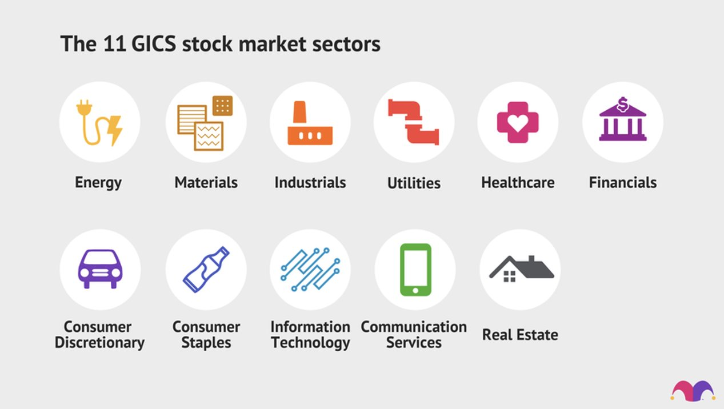
Industry Performance
What industry is your target firm situated in?
Is the industry growing? Check Indices and Market trends
What is the market share of your company
How fierce the competition
competitive: construction, apparel
Oligopoly: airplane manufacturing
Monopolistic: facebook?
How is your company situated in this industry?

Slide 5
Fundamentals
Revenue and earnings (trends, figures)
Financial ratios
Debt management
Valuation

Slide 6
Discounted cash flow model
Next time!

Slide 7
Comparables
Next time

Slide 8
Technical Analysis
Only if applicable
Indicators, trend lines, support lines
Fibonacci levels, oscillators

Slide 9
Risk
Examples
Highly competitive market
Inflation
Commodity exposure
Geopolitical risks
Look at what the company says in their reports!

Slide 10
Proposal and Exit strategy
Buy 10% of portfolio
Stoploss?
Hold until the end of competition
Reasons:
Exit: what should happen for us to sell (catalysts, risks materializing)

Slide 11
Thank you.

